Slide 1
Inheritance and Polymorphism in PHP (OOP)

Slide 2
Learning Objectives
1. By the end of this lesson, you should be able to:
2. Understand the concept and purpose of inheritance in OOP.
3. Understand the relationship between base and derived classes.
4. Demonstrate method overriding to customize inherited behavior.
5. Use the parent:: keyword to enhance inherited methods in derived classes.
6. Explain and implement polymorphism using a common base class.

Slide 3
What is Inheritance?
Inheritance allows a class to reuse the properties and methods of another class.
The base class is also called the parent class.
The derived class is also called the child class.
Promotes code reuse and modularity.

Slide 4
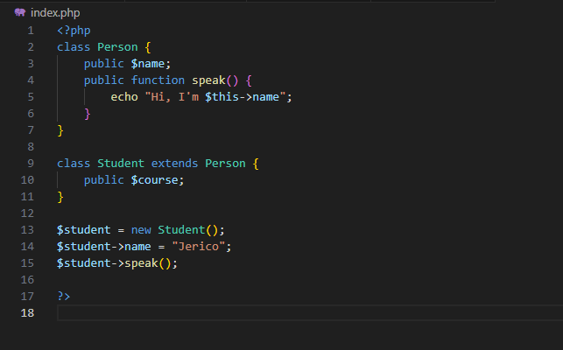
SYNTAX EXAMPLE

Slide 5
What is Method Overriding?
Method overriding allows a child class to redefine a method from the parent class.
Used to customize or change inherited behavior.

Slide 6
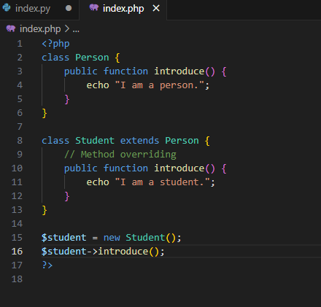
SYNTAX EXAMPLE

Slide 7
Roles of Base and Derived Classes
Role | Description
Base Class | The general class (e.g., Person)
Derived Class | The specialized class (e.g., Student)

Slide 8
Types of Inheritance
1. Single Inheritance
-A child class inherits from only one parent class.
2. Multilevel Inheritance
-A class inherits from another class, and then another class inherits from it (a chain).
3. Hierarchical Inheritance
-Multiple child classes inherit from the same parent class.

Slide 9
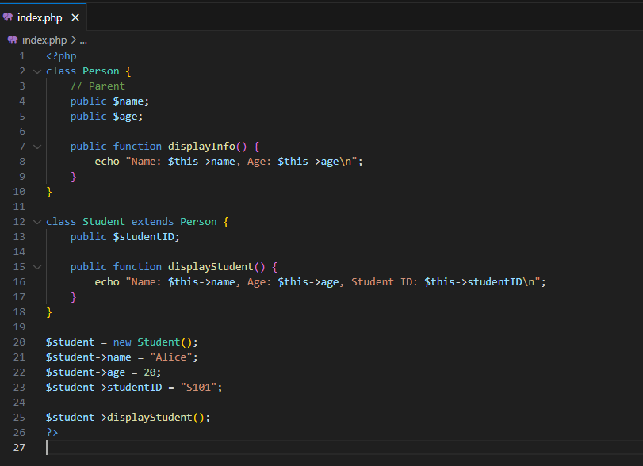
Single Inheritance

Slide 10
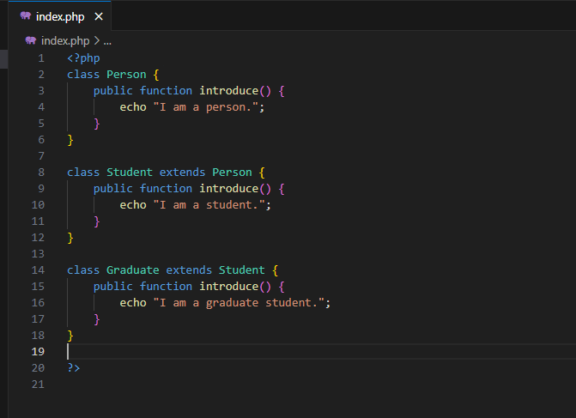
Multi level Inheritance

Slide 11
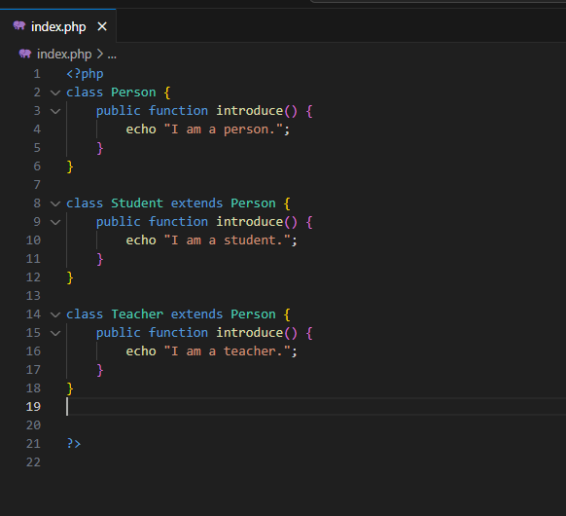
Hierarchical Inheritance

Slide 12
Using parent:: to Extend Behavior
Use parent::methodName() to call the original method from the parent class.
Useful when the child needs to extend, not fully replace, the behavior.

Slide 13
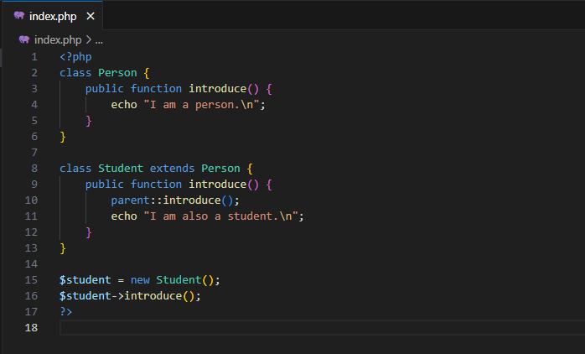
Using parent:: to Extend Behavior

Slide 14
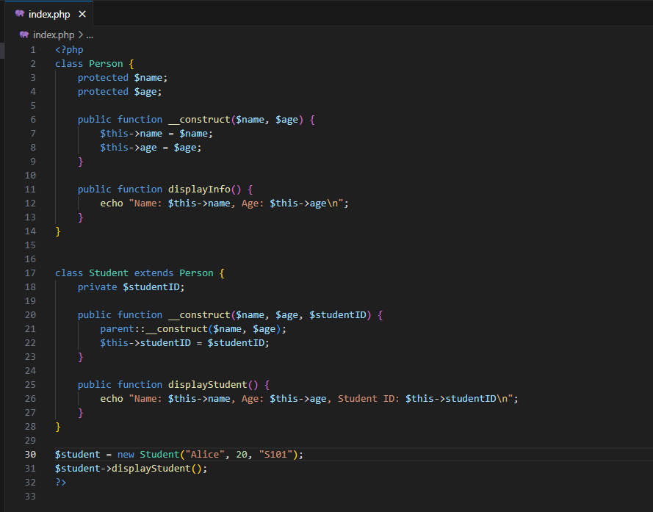
Inheritance with constructors
Notes:
<?php
class Person {
// Parent attributes
protected $name;
protected $age;
// Parent constructor
public function __construct($name, $age) {
$this->name = $name;
$this->age = $age;
}
public function displayInfo() {
echo "Name: $this->name, Age: $this->age\n";
}
}
// Child class inherits from Person
class Student extends Person {
private $studentID;
// Child constructor
public function __construct($name, $age, $studentID) {
// Call parent constructor
parent::__construct($name, $age);
$this->studentID = $studentID;
}
public function displayStudent() {
echo "Name: $this->name, Age: $this->age, Student ID: $this->studentID\n";
}
}
// Create object of Student
$student = new Student("Alice", 20, "S101");
$student->displayStudent();
?>

Slide 15
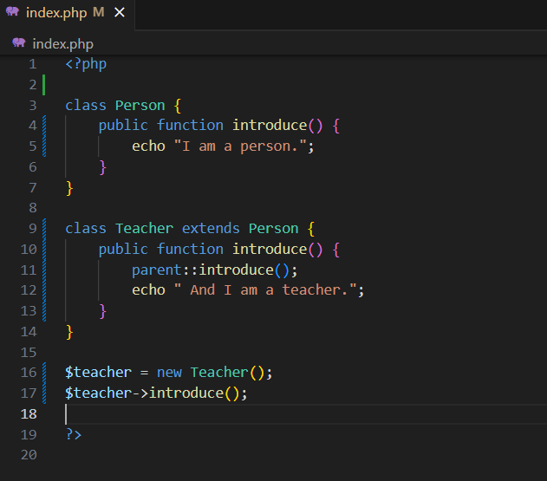
SYNTAX EXAMPLE

Slide 16
What is Polymorphism?
Polymorphism means one interface, many behaviors.
Different classes can implement the same method name differently.
Achieved through method overriding.

Slide 17
Concept of Polymorphism
All child classes inherit from the same base.
Each class overrides a method (e.g., introduce()).
You can treat them as the same type (e.g., Person) in your code.

Slide 18
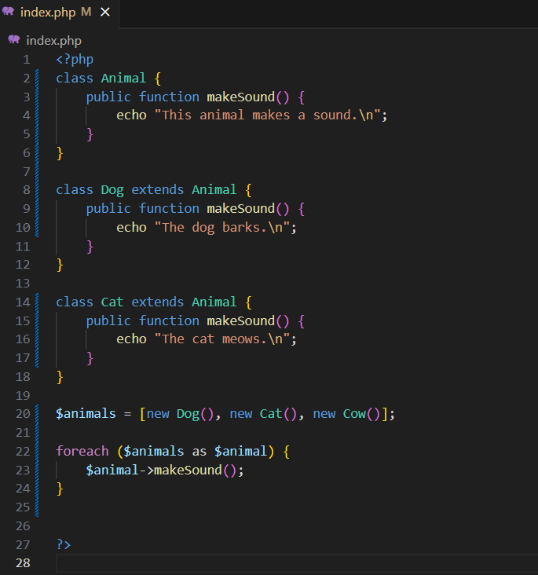
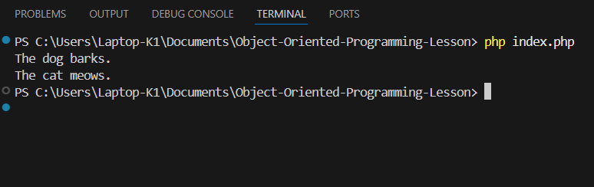
SYNTAX EXAMPLE

Slide 19
Summary
Concept | Description
Inheritance | Share and reuse code using base and derived classes
Method Overriding | Redefine inherited methods to customize behavior
parent:: | Extend inherited method logic using the parent keyword
Polymorphism | Use the same method across different objects with different behavior

Slide 20
Thank you

